Slide 1
Python (day 2)
Nick Anderson

Slide 2
Python Check-Up (your turn, 10 min.)

Slide 3
Python Check-Up (your turn, 10 min.)
Print "Hello User!"
Then ask: "What is your name? "
Then respond: "Hello <user's name>"
Then ask: "What is your age? "
Then respond: "Awww... you're just a baby!" or "Ah... A well traveled soul are ye." depending on the user's age.
Hints: remember to cast your variables!

Slide 4
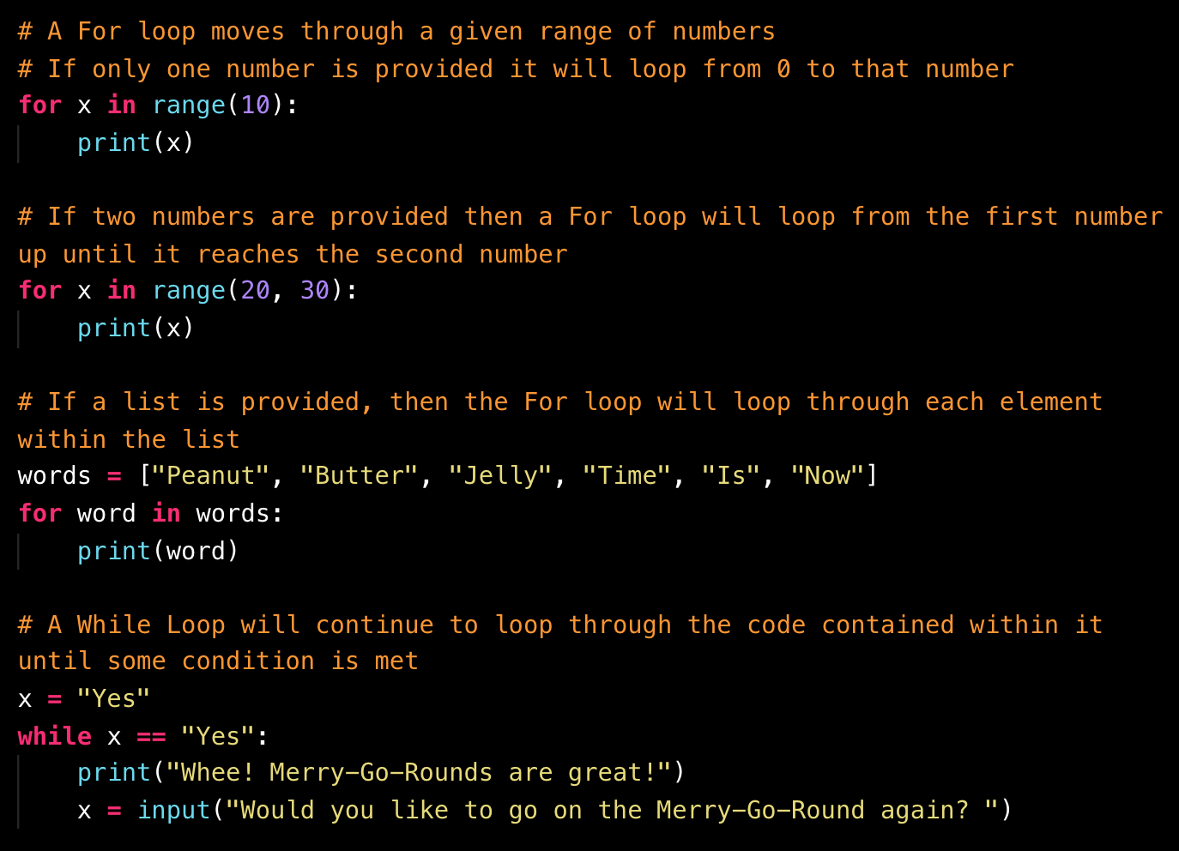
Loop Recap

Slide 5
Kid in a Candy Store

Slide 6
Kid in a Candy Store (your turn, 15 min.)
Print all of the candies with their index.
Run the loop for the number of times as determined by the variable allowance.
Each time the second loop runs, take in a user's input (as an integer), then add the candy with a matching index to the variable "candyCart".
Use another loop to print all of the candies selected to the terminal.

Slide 7
House of Pies

Slide 8
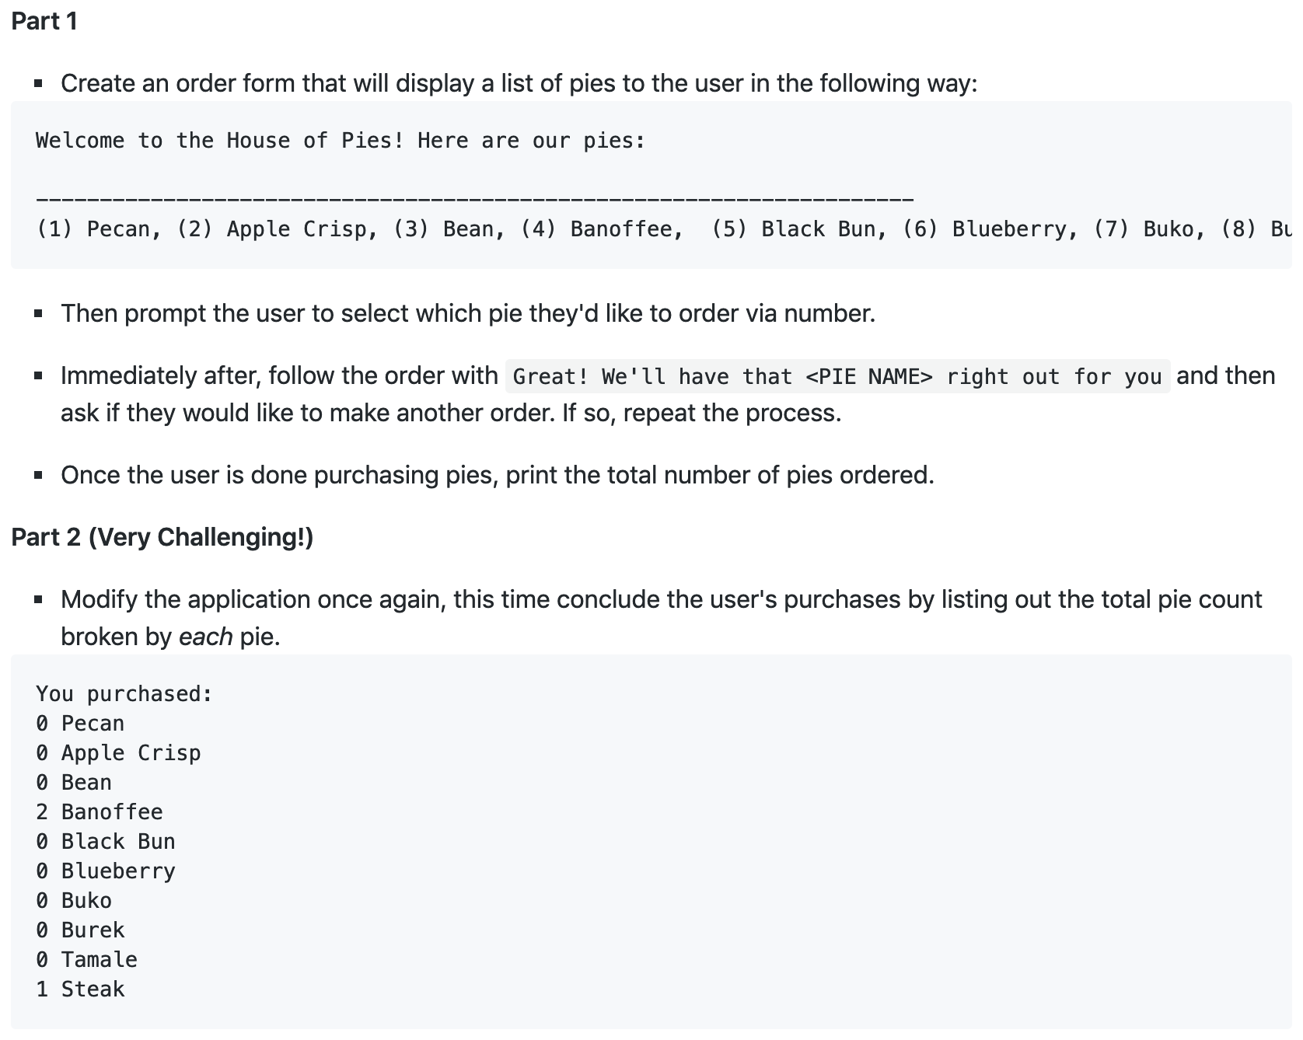
(your turn, 20 min.)

Slide 9
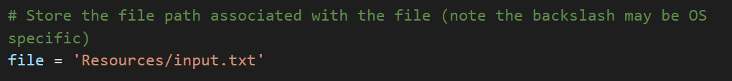
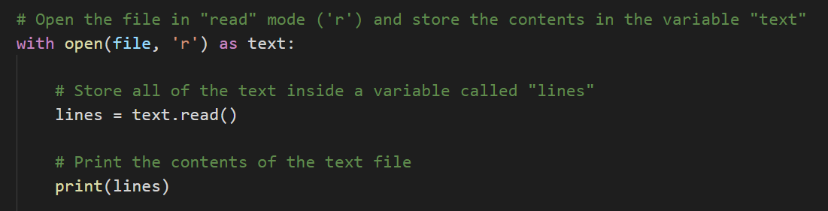
Reading Text Files

Slide 10
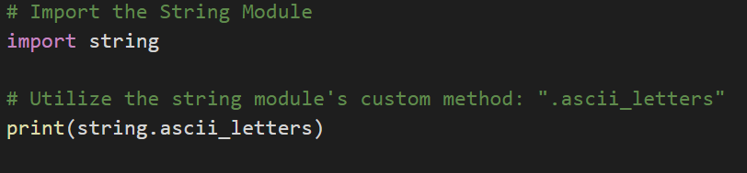
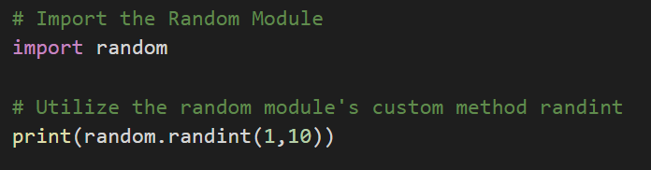
Introduction to Modules (part 1)

Slide 11
Introduction to Modules (part 2)
Go to the link below and see the standard library of modules for Python.
https://docs.python.org/3/library/index.html
What do you think you would use?
What do you think a business might use?

Slide 12
Break (15 min.)

Slide 13
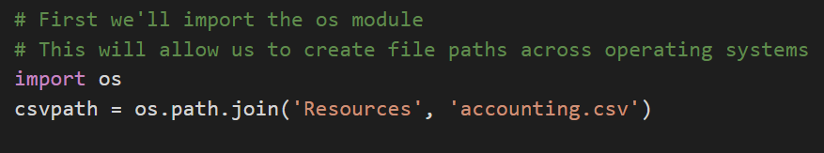
Reading in CSVs (part 1: specify path)

Slide 14
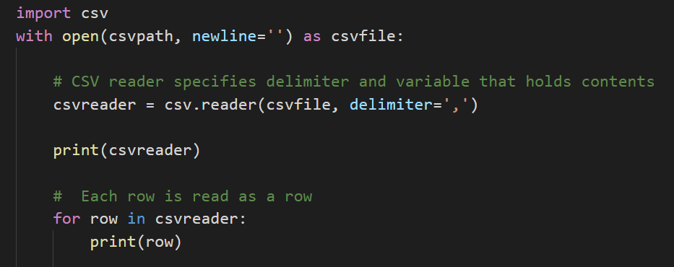
Reading in CSVs (part 2: read file)

Slide 15
Reading NetFlix (your turn, 15 min.)
Prompt the user for what video they are looking for.
Search through the netflix_ratings.csv to find the user's video.
If the CSV contains the user's video then print out the title, what it is rated and the current user ratings.
For example: 'Grease is rated PG with a rating of 86'

Slide 16
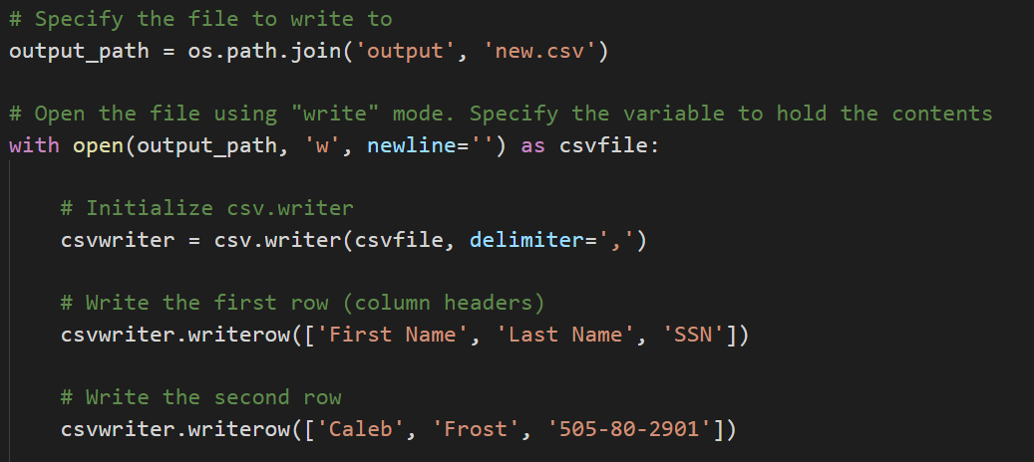
Writing CSVs

Slide 17
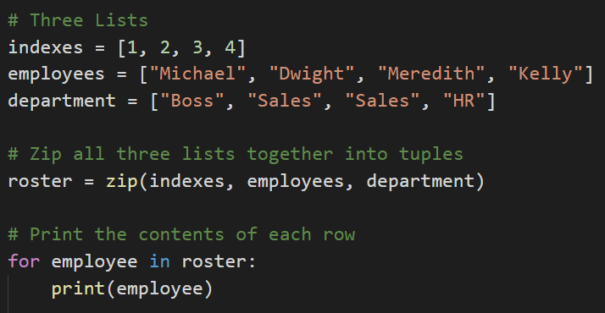
Zipping Lists

Slide 18
Udemy Zip (your turn, 20 min.)
Read in the data on Udemy offerings. Store the contents of the Title, Price, Subscriber Count, Number of Reviews, and Course Length into a lists. Zip these lists together into a single tuple. Write the contents of your extracted data into a CSV. Include the titles of the columns. Columns"id,title,url,isPaid,price,numSubscribers,numReviews,numPublishedLectures,instructionalLevel,contentInfo,publishedTime"

Slide 19
Introduction to Functions (part 1)
DRY stands for Don't Repeat Yourself!
If you decide to be a coder or work with coders, they’ll expect you to not repeat yourself ;)
This is done by using functions!!!

Slide 20
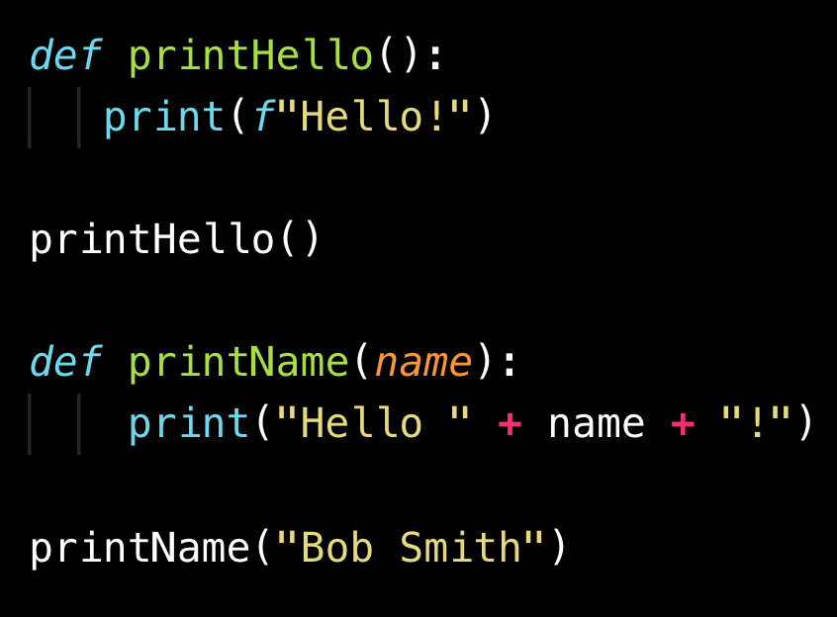
Introduction to Functions (part 2)

